Slide 1
PwC Power BI
PwC Switzerland virtual Internship Feb.-march 2025.
By :- Jagruti . C

Slide 2
Task Overview
What I’ll learn
The importance of digital transformation and upskilling in today's business landscape.
The purpose and goals of the Digital Accelerator program.
What I'll do
Watch videos on digital upskilling and the journey of driving a digital mindset.
Reflect on the provided self-reflection question and respond in the text field.

Slide 3
Here is the background information on your task
All in on digital transformation: Creating a stronger, nimbler, more resilient future!
We aim to build innovative technology solutions that differentiate us from our competitors and digitize the business. Part of that included a strategic decision to invest in upskilling programmes so our people could learn how to use digital tools for data visualization as well as automation, data cleansing and more.
If our people could use these tools to solve common problems, they’d help us become more efficient and growth-oriented now and more innovative later in Business Services and beyond. Now, employees are learning to build bots – over 2,400 have been created so far – to automate workflows. We continue to invest to make processes more intuitive using machine learning, Power BI and eventually artificial intelligence (AI). These are key to working faster and solving problems differently for ourselves and our clients.
This is why you're here! Our Digital Accelerator programmer is an internal chance that takes groups of our employees out of their day jobs and puts them through trainings that teaches them skills in technology such as automation, machine learning, design thinking, and digital storytelling. Power BI is an important part of it as visualizing data helps to handle and understand clients.
So, become a Digital Accelerator yourself and start your Power BI journey with us!

Slide 4
Here is your task
But before you start, we would love to hear from you. Let’s set the mood to start your experience in Power BI.
First, watch the video ‘New world. New skills. PwC's journey to drive a digital mindset’ for inspiring insight on Digital Upskilling and the next video to hear from our Global Chairman, before kick-starting your journey through this program.
Next, navigate to the next page and respond to the self-reflection question by filling out the provided text field. No additional resources are required.

Slide 5
Task 2: Call Centre Trends
What you'll learn
The importance of upskilling in the digital age and its role in the workplace.
The concept of becoming a "Digital Accelerator" and the skills associated with it.
How to create a Power BI dashboard for visualizing key performance indicators (KPIs) and metrics.
What you'll do
Create a dashboard in Power BI for visualizing relevant KPIs and metrics in the dataset provided.
Utilize the resources provided, including podcasts and articles, to enhance your understanding of data visualization and upskilling.
Respond to the client's request by providing a well-designed Power BI dashboard reflecting the requested KPIs.

Slide 6
Here is your task 2
It’s omnipresent: telecom marketing. Better price here. Better service there. Best for small businesses here. Best for young urbanites there. But what do customers really want? Our client, a big telecom company needs to know. This email just arrived for you:
Create a dashboard in Power BI for Claire that reflects all relevant Key Performance Indicators (KPIs) and metrics in the dataset. Get creative!
Possible KPIs include (to get you started, but not limited to):
Overall customer satisfaction
Overall calls answered/abandoned
Calls by time
Average speed of answer
Agent’s performance quadrant -> average handle time (talk duration) vs calls answered

Slide 7
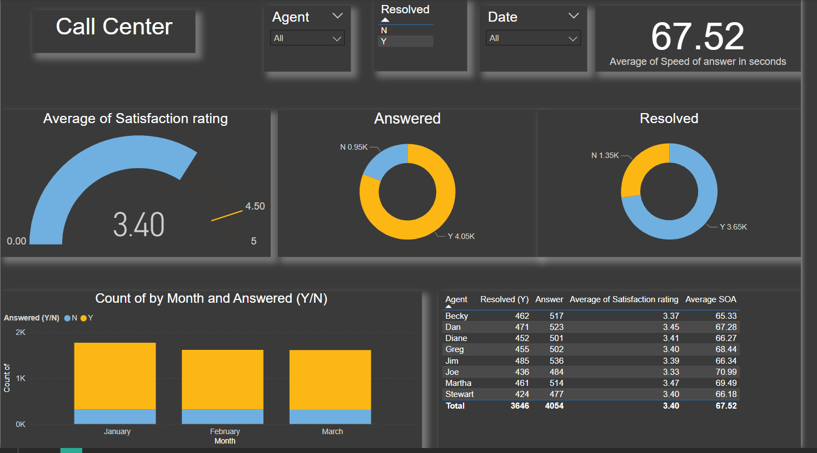

Slide 8
Task 3: Customer Retention
Here is your task 3
Your colleague, the engagement partner, asks you to do the following tasks:
Define proper KPIs
Create a dashboard for the retention manager reflecting the KPIs
Write a short email to him (the engagement partner) explaining your findings, and include suggestions as to what needs to be changed

Slide 9
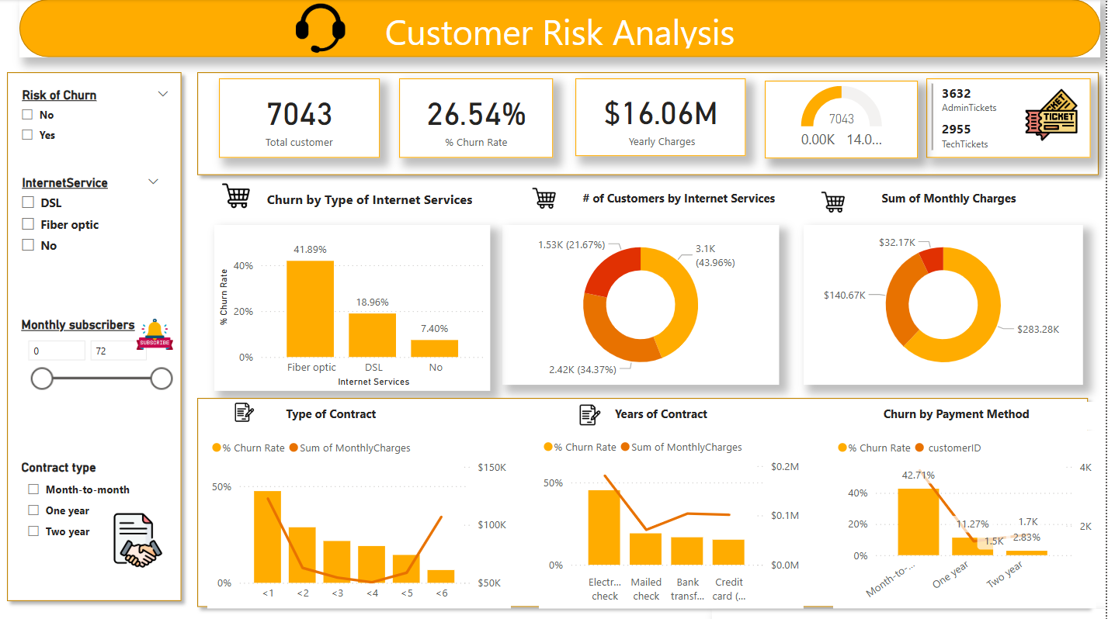

Slide 10
Task 4: Diversity & Inclusion
Your task is to do the following:
Define relevant KPIs in hiring, promotion, performance and turnover, and create a visualization
Write what you think some root causes of their slow progress might be

Slide 11
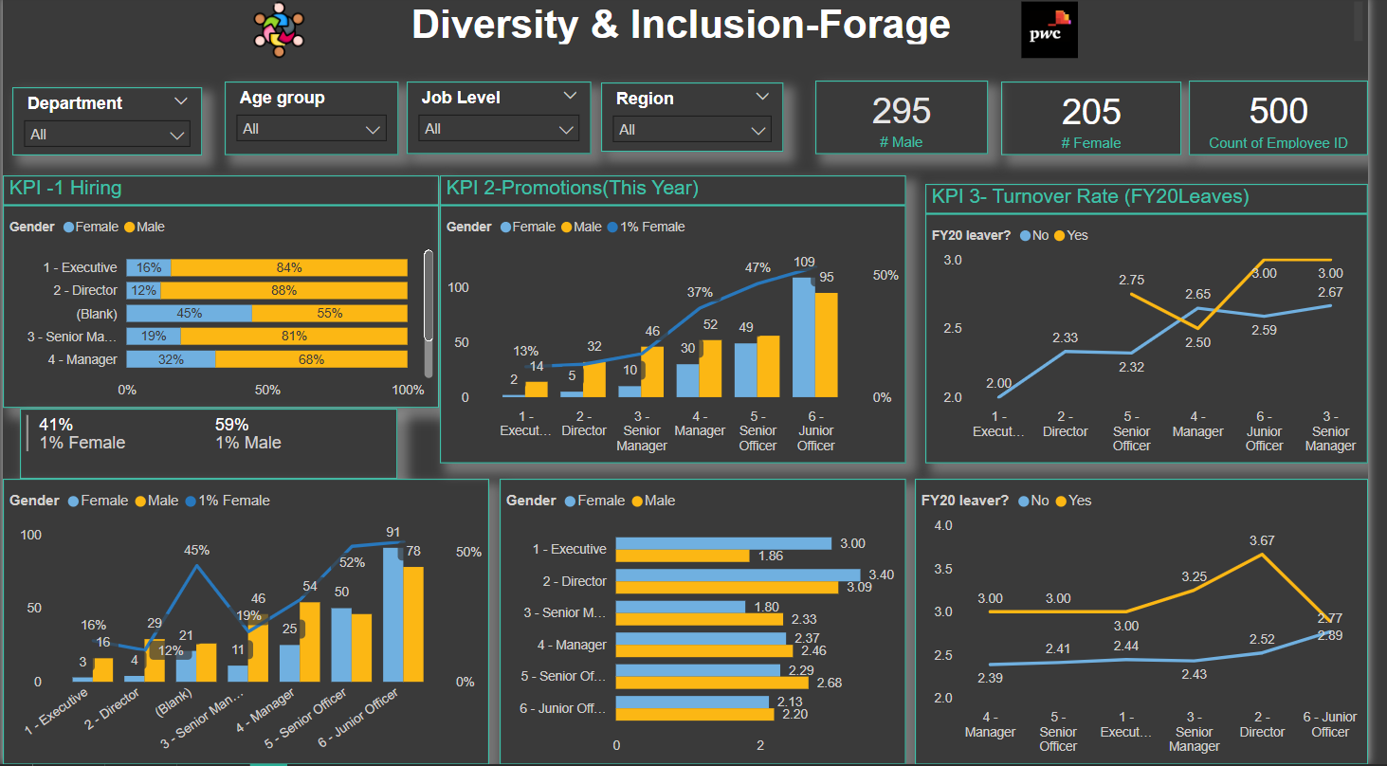

Slide 12
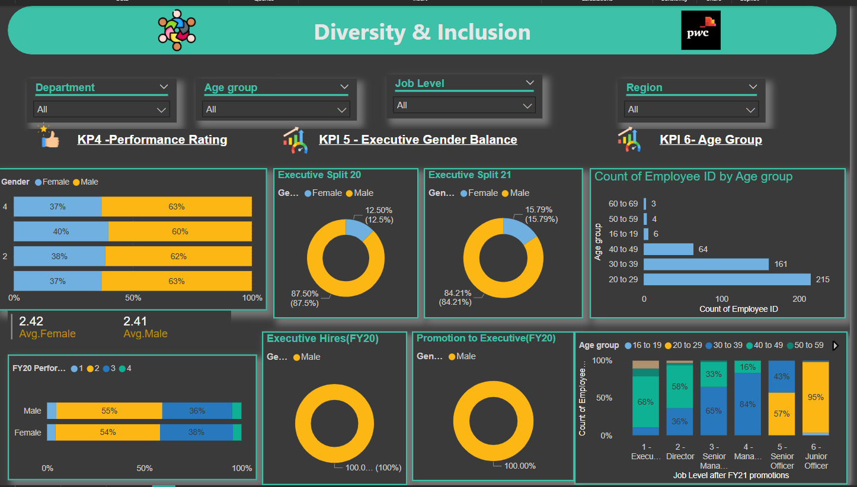

Slide 13
